Slide 1



The 18th International Conference on Power Electronics and Motion Control
Comparison of Inverter Topologies Suited for Integrated Modular Motor Drive Applications
Hakan Saraç
hakan.sarac@metu.edu.tr
Department of Electrical and Electronics Engineering
Middle East Technical University

Slide 2

Outline
Introduction
Integrated Modular Motor Drive (IMMD) Technology
Inverter Topologies
Evaluation & Results
References

Slide 3
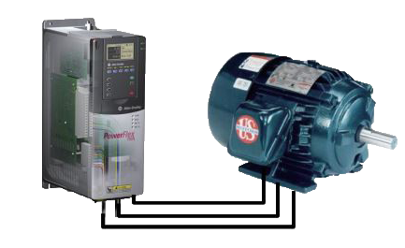
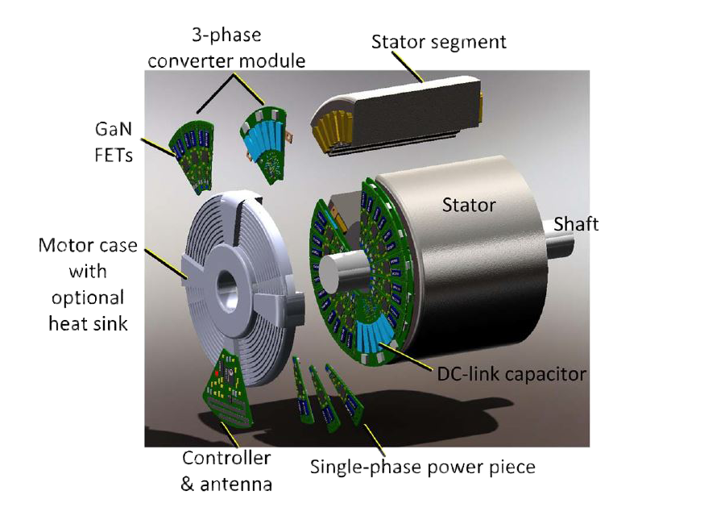
Introduction
Drive and motor are separate
Long cable effect
Low power density
[5]
Drive and motor are integrated
Reduced overall size
Modular structure
Fault tolerance capability
[1]

Slide 4
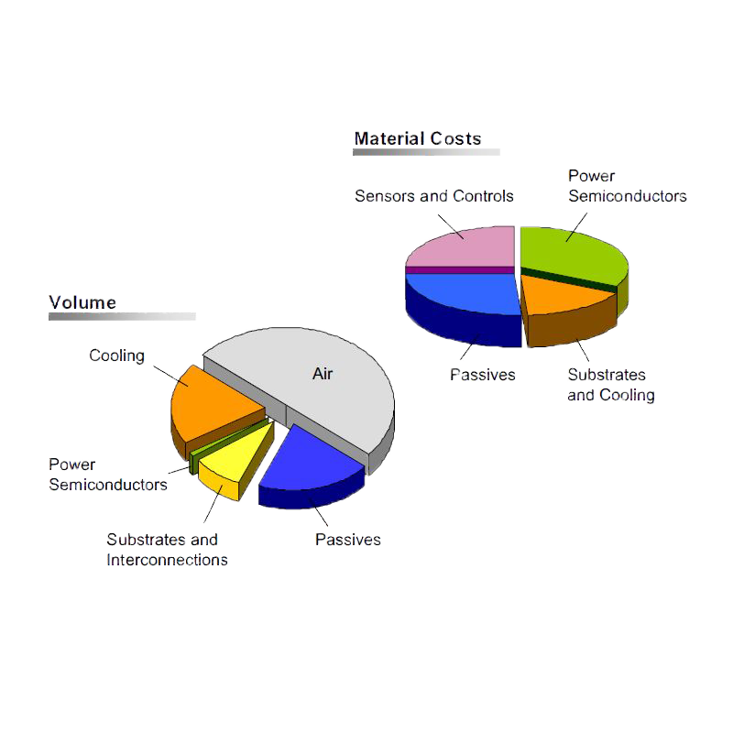
IMMD Technology
Drive challenges in IMMD
Mechanical vibration
Compact drive circuit
High switching frequency
Interleaving between parallel inverters
Cooling
Efficient transistors
[3]
Notes:
How to achieve compact drive and cooling?

Slide 5
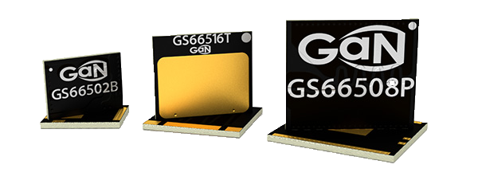
Inverter Topologies
GaN transistor
Advantages
Low switching energy
Disadvantages
Low voltage rating
High dV/dt

Slide 6
Inverter Topologies
Series configration
Voltage rating of GaNs
Lower dV/dt
Parallel configration
Smaller capacitor size
Lower switching losses
Notes:
Interleaving in series
150 microjoule for 60A
55 microjoule for 30A

Slide 7
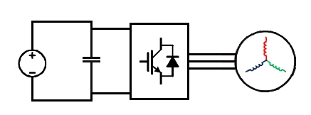
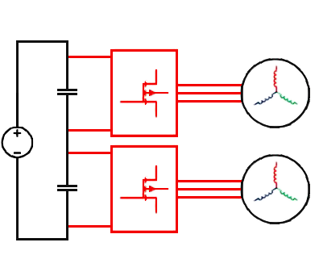
Inverter Topologies
2 level VSI with IGBT
540 Vdc
Modules 1,2,3,4
2 level 2 series VSI with GaN
Modules 1,2
540 Vdc
Modules 3,4

Slide 8
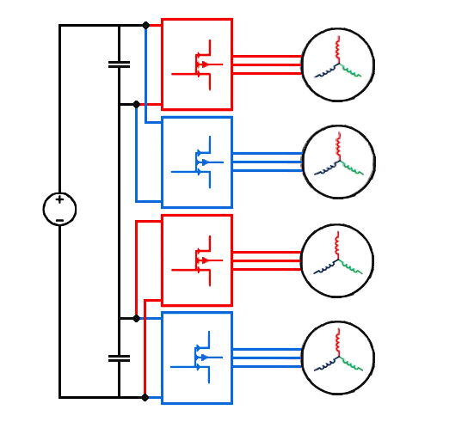
Inverter Topologies
2 level 2 series 2 parallel VSI with GaN
Module 1
Module 2
540 Vdc
Module 3
Module 4

Slide 9
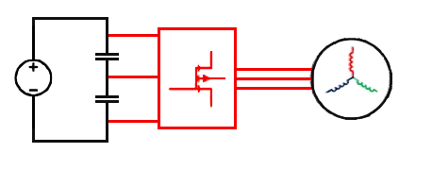
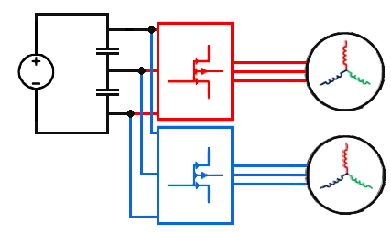
Inverter Topologies
3 level NPC VSI with GaN
540 Vdc
Modules 1,2,3,4
3 level 2 parallel NPC VSI with GaN
540 Vdc
Modules 1,2
Modules 3,4

Slide 10
Evaluation & Results

Slide 11
Evaluation & Results
10kHz
50kHz
50kHz
50kHz
50kHz

Slide 12
Evaluation & Results

Slide 13
Evaluation & Results

Slide 14

Hakan Saraç
hakan.sarac@metu.edu.tr
Department of Electrical and Electronics Engineering
Middle East Technical University
http://power.eee.metu.edu.tr/

Slide 15
References
[1] J. Wang, Y. Li and Y. Han, "Integrated Modular Motor Drive Design WithGaNPowerFETs," in IEEE Transactions on Industry Applications, vol. 51, no. 4, pp. 3198-3207, July-Aug. 2015.
doi: 10.1109/TIA.2015.2413380
[2] J. Wang and Y. Han, "A new concept of multilevel converter motor drive with modular design and split winding machine," 2014 Power and Energy Conference at Illinois (PECI), Champaign, IL, 2014, pp. 1-6.
doi: 10.1109/PECI.2014.6804550
[3] M. März, A. Schletz, B. Eckardt, S. Egelkraut and H. Rauh, "Power electronics system integration for electric and hybrid vehicles," 2010 6th International Conference on Integrated Power Electronics Systems, Nuremberg, 2010, pp. 1-10.
[4] N. R. Brown, T. M. Jahns and R. D. Lorenz, "Power Converter Design for an Integrated Modular Motor Drive," 2007 IEEE Industry Applications Annual Meeting, New Orleans, LA, 2007, pp. 1322-1328.
doi: 10.1109/07IAS.2007.205
[5] T. M. Jahns and H. Dai, "The past, present, and future of power electronics integration technology in motor drives," in CPSS Transactions on Power Electronics and Applications, vol. 2, no. 3, pp. 197-216, Sept. 2017.
doi: 10.24295/CPSSTPEA.2017.00019
[6] GaN Systems, “GaN Systems.” [Online]. Available: http://www.gansystems.com/. [Accessed: 15-Jan-2018].
[7] Infineon, “Infineon IGBTs.” [Online]. Available: https://www.infineon.com. [Accessed: 07-Mar-2018].

